Slide 1
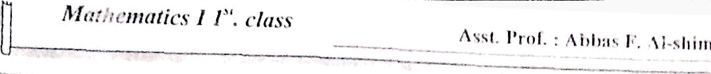




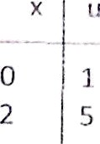






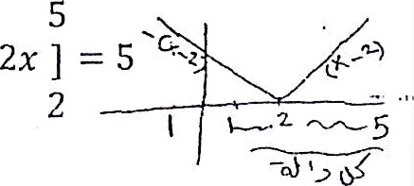
—
^ s*' l'r‹".
A1›l›.i• i'’. i i-›l, ion n,:. r,
(#)*
1
^{Ex} / Evaluate
f,
sin ⁵ 2z cos 2x dx dli = cos 2x (2 dx)
Let
u- sin 2k
2
cos 2x dx
X | U
0 | 0
J _{u}^{S} du ——
1
2
p6
6
2
Ex: Show that fp’ ² sin“ x dx --
Ț ’ ² sin" x dv — )_{o}"” cos (y — x )"dx
' ² cos^{n}
dx
let u —— — — x
du —— —dx
J ’ ² cos* u du
0
z/2
cos" u du’
Ex / Evaluate
f(x) dx
if /(z) ——
2
3a-2, x? 2
6
6
f(x) dx ——
z' dx -b (3s — 2) dx
2
)+(
0
3i’
2
6
— 2z) ]
2
128
3
3
—₂+
2
2x ] + [ ₂ —
1
41

Slide 2
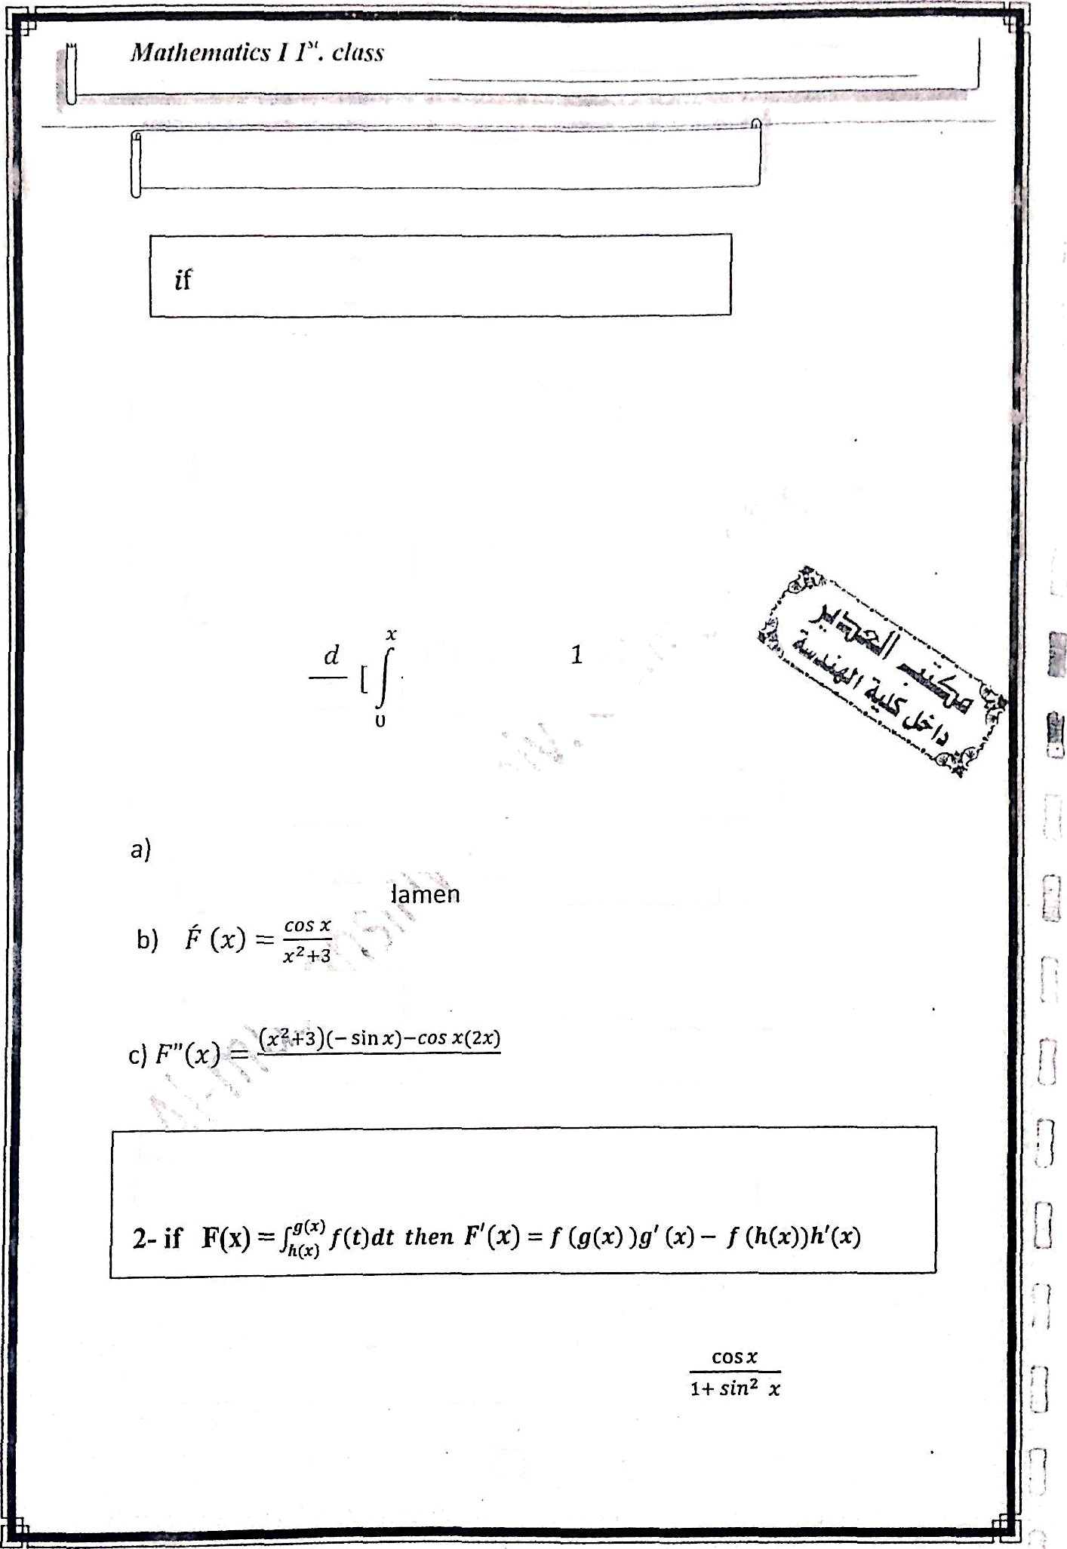
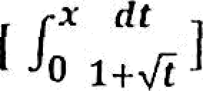





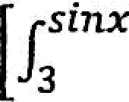
The Scc‹ıııd I'ııııtIiı ıııcm.ıl Tlıc‹›ı•cııı ‹›f lııtcgı:ıl
r•(x) = J, t(fi) dt
ı/‹e» f' r) — f x)
Ex / Find F (x) i f r(.‹) — // ,” «
By the ? ‘ film *ll3cntal theorem of llılC 1111. Û (r) —
E› e rı»d
d
dz
by' the 2 "'
fundaısıental lheoıeln of intcgral
d
dx ı + •€t' ı + ,/F
Ex: Find F(fi) , Î (o) and F”(o) if
0 COS _{dt}
F(x) = J_{O}
COS t _{dt}
by the second funr tat theorem of calculus
F (0) —
.
.3
COS
(0)
3
F"(0) = ^{O-O O} = 0
(>* -F 3) ²
(0-1-3)'
9
Note
1- ¡ç F(x) =
f*p"'f(t) dt
then F’(x) —— f (p(x))ğ (x)
EK /
d dx
ı+M
dt
1 1+(sin x)²
(cos x) =
42

Slide 3
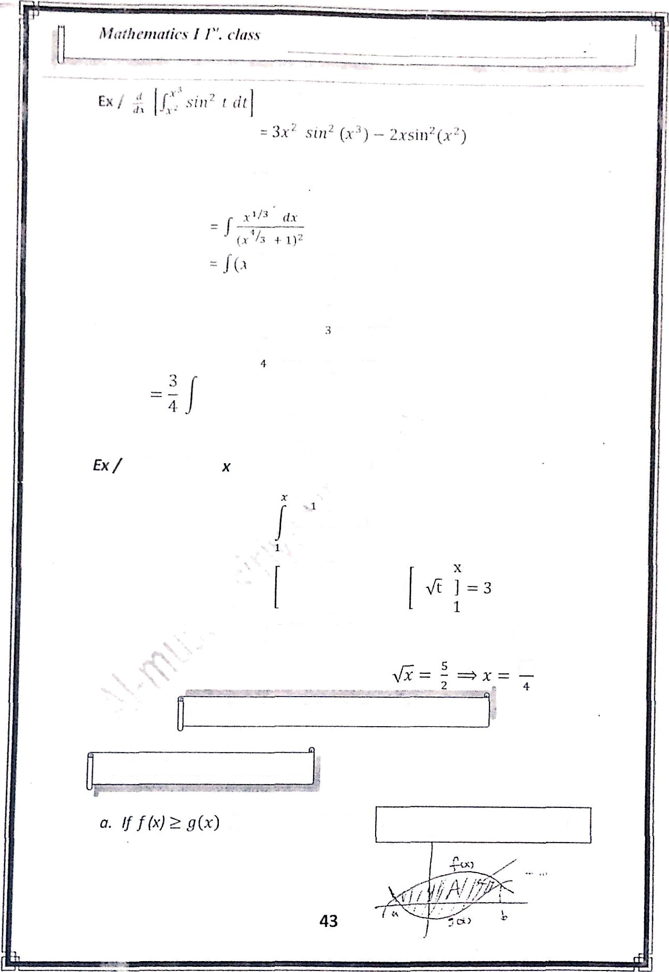

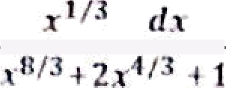



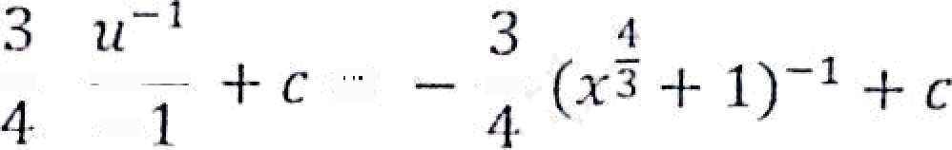
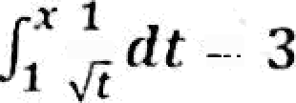


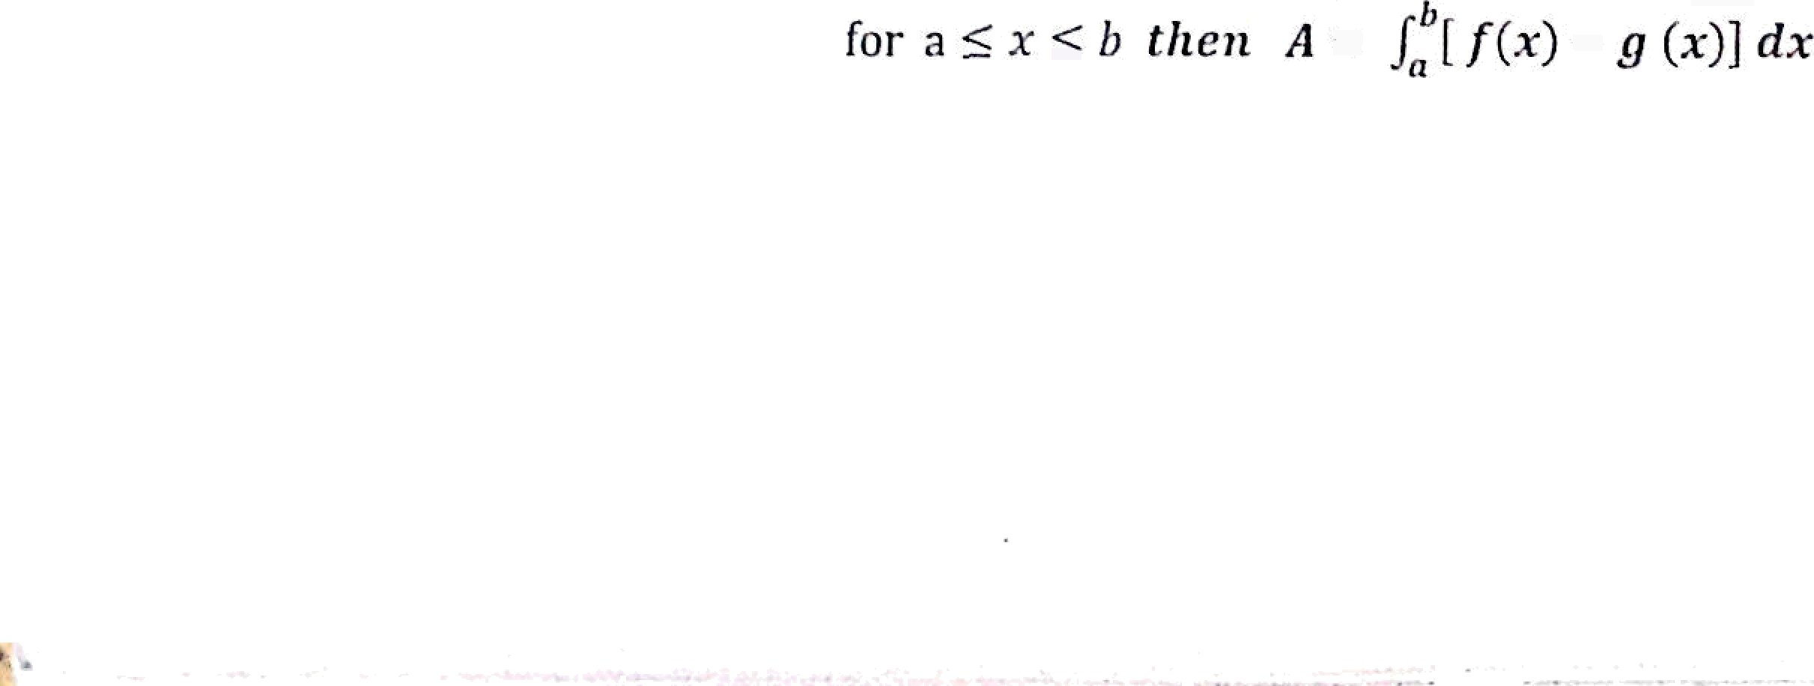
£ofre for
1/2
] 3 -• 2
1
25
Application of the definite integral:
1-Area bettveeii two curves:

Slide 4

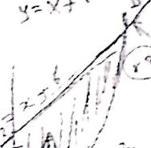

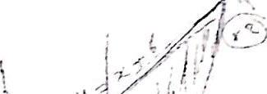
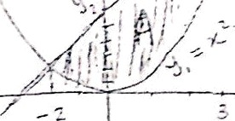



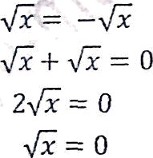










Math eittatics I I”. class
Ex / Find the a rea of the region enclosed bcti*'een the cu rvcs
*' = x + 6
Check x — 0
y = 0 be low)
A' )_₂₍ ₁₂
2 =
6 (above)
)dx —— J ^{R}, ((z + 6) — x ^{Z} ] dv
= + 6z — '
J
2
= (
+ 6 (—2) — (
i25 6
.
)
Ex / Find the area of the région enclosed between the curves
x -- y’ rznd y —— x: - 2
Method (1)
x= (x
—2)'
z' — Sz + 4= 0 (z — 1)(z — 4) = 0
'
Z =
A —— Az +
z = 1 z = 4
A₂
1

Slide 5
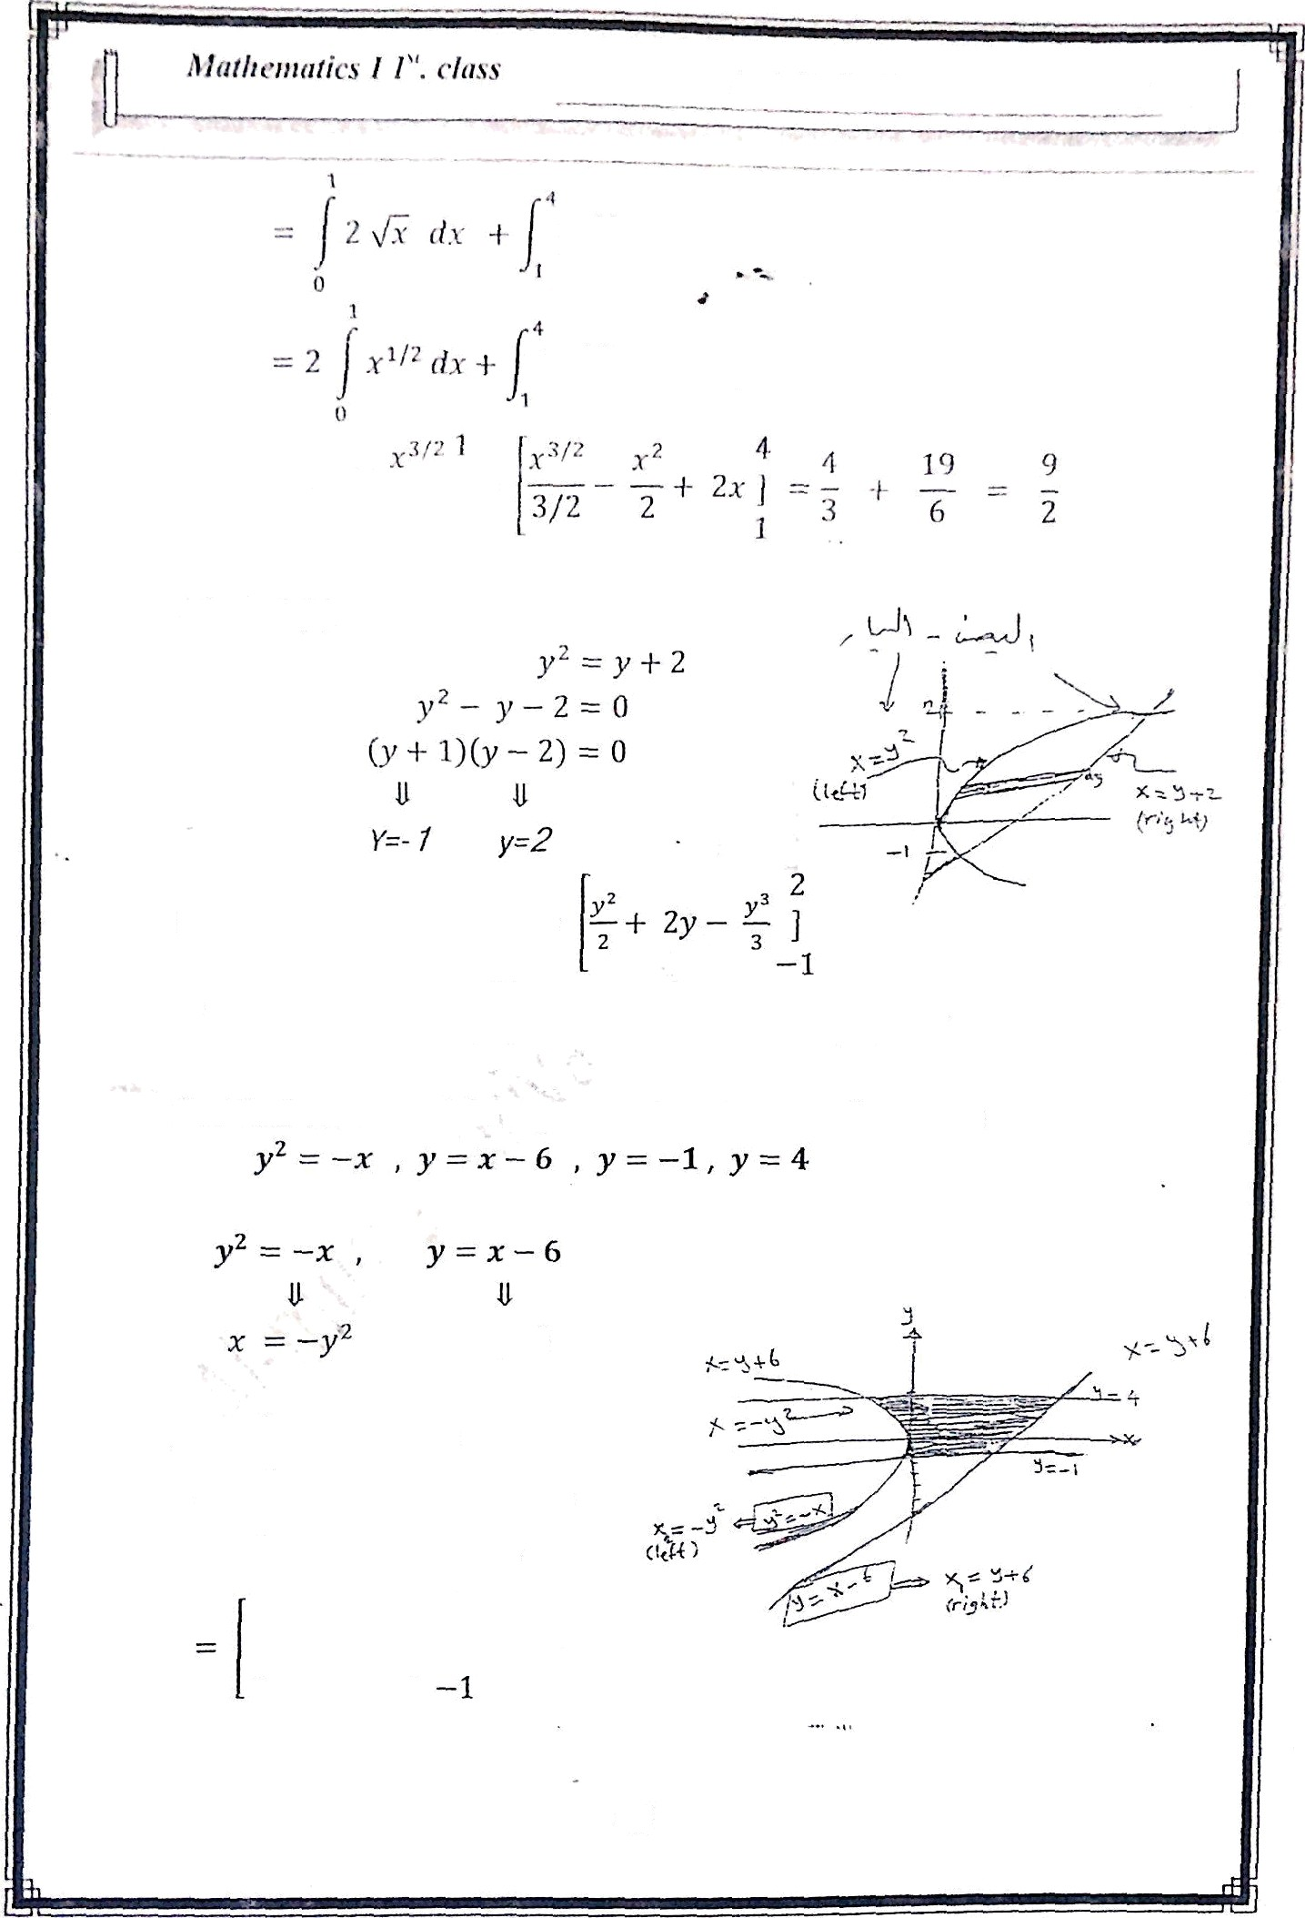








[ ›/ - x -F 2[4z
Method (2)
A= /' [(y
-r 2) — y^ ] dy ——
= ( 2' — 2 (2) —
3
^{p}(-1)'
(- )
9
2
2
Ex / find the area of the region enclosed between the curves
A —- f (xz - xz )d y
ié i(y ⁺ ⁶ ⁻
— y')) dy
= J [y + 6 + y²] dy
+ 6y +
, 4
160
3
45

Slide 6
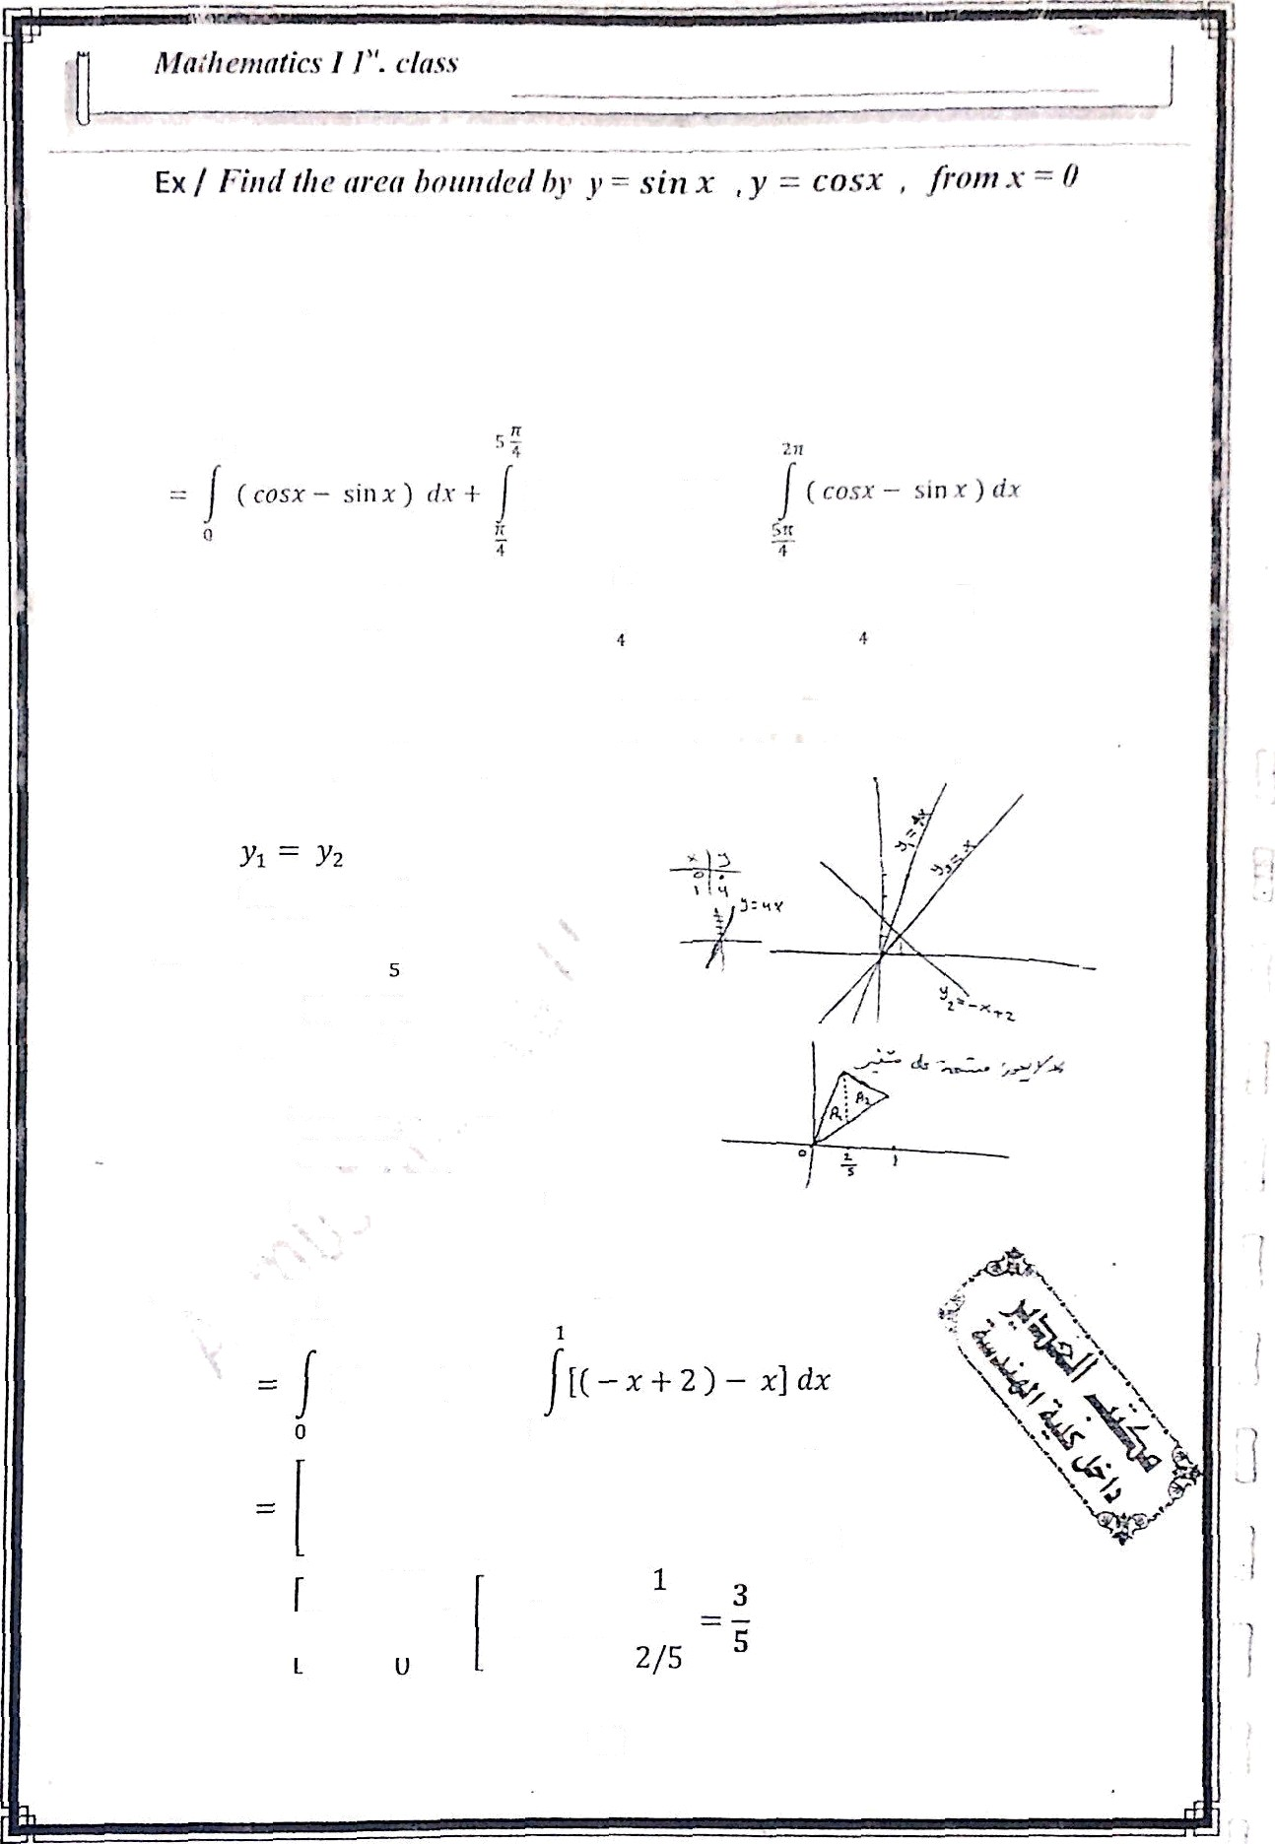















8 n
ix Z Find the area of the region «»rfoseff between the curves
y x , y 4x , y -x + 2 , sketch the re gion .
4x
x-F2
*X
y2 xc
— + 2
A = A 1 +
A ₂
2/5
(4x ›)d‹+
2/5
1
' 0
_{x}2 2/5
46

Slide 7
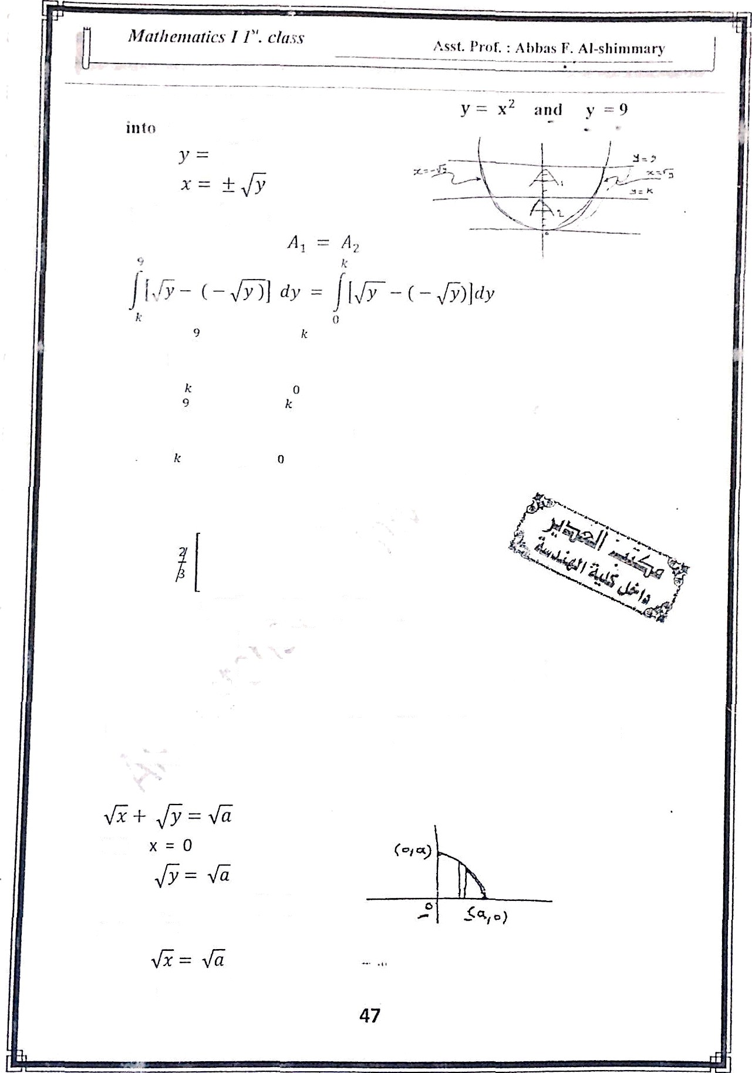
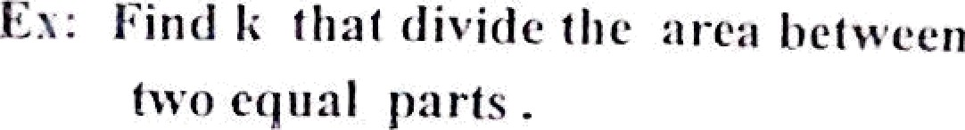









to be equal parts
2
y dy = 2
y d y
y' ² d y ——
1 /2 _{dy}
3/2 _{k}
9
/2
o
k
k
₉ 3/2 _{— k} 3 f2
_{8=2k}3/2
_{4 = k}3/2
0
k’!’ - 0
₄ 2/3
k
—i k —— \/lit
Ex / Find the area bounded by
axes.
x -F y -
and the coordinate
Put
y = n (0, o)

Slide 8
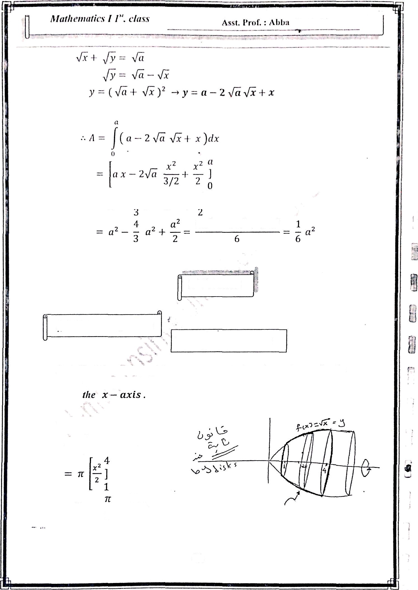

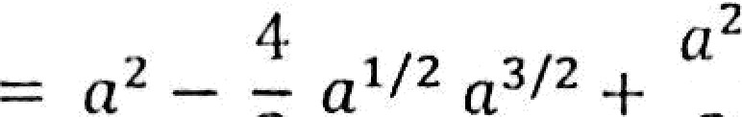

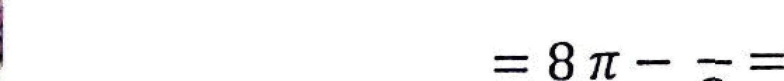
2-Volumes
2.I Volumes by Disks
P = JJ ir (ÿ(x))' dx
Ext’ Find the votuoie oftlie solid obtained when the region nitder the curve’ ÿ - JÑ over the interval [1, 4] is revolved about
’V —— q’f ^{b} ti (f(x))’ dx
r= /4
[•/*x]²dx
lsr
48

Slide 9












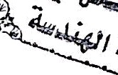

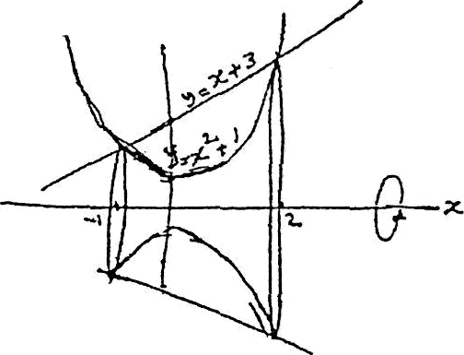

Asst. I*r‹›f. : Al›l›as TRAI-slin›ni:my
2.2 I nfitiite.v hy tvasIier.s.
I.“.x .’ I-”uul tltc• vuluute of dli‹' solid fțeiu'rut‹•‹l ic/i‹ui tli‹• r •p=iou heltveeii
/(z) -l- y2 , g(x) = x u sper [0, 2] is revofve‹l ahoat the x - axis .
•— r/• [‹f(.))2 — ;s‹• )› ]d•
g¹ + 2 2 (g) 2 ]
2
dx
2
1
_{z} 4
dx
0
_{i} y 5 2
69z
' x 4
x + ₅ ] =
10
’ “=
0
Ex: find the voluñie‘ generated by revolving the area enclosed by
3 — x ² + 1 ,
r
z ² + I
_{x} 2
(x -F 1)
y = x + 3 about the x - axis
y2
— x + 3
x - 2 = 0
(x - 2) = 0
J———1 i=2
By washer method
49

Slide 10


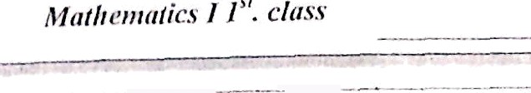


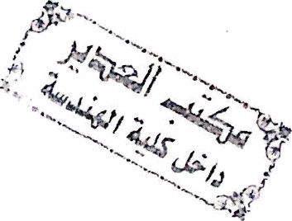
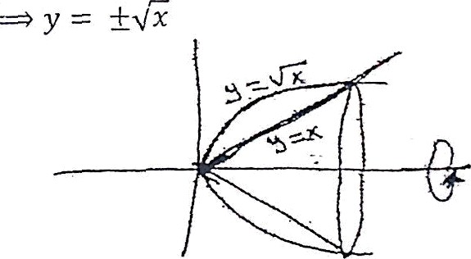

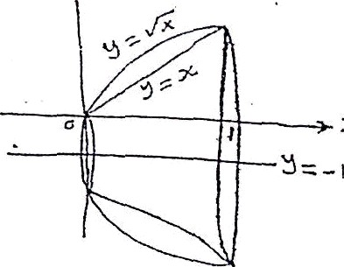
-1
= r [x* +
6x -F 9 — x° — 2x* — tj dx
- r [—x’ — _{x}² + Gx + 8) dX
X'
X’
2
27R
= x
———— — 3 x' + 8x ]
=
5 3
—1 '
_{EN Fiitd} the volume of solid p•eiierttled by revolving ^{the region}
enclosed by x -
_{J} 2
fed x — y
I- about the x- xis
2- aboiii the Line y - -1 .
- 1- about the x — oxi$
y1
z — y'
y2
z' — = 0
x (x — 1) = o
By W^{x} ash”ër method
b
1
= ri ((
)' — (x)²) dx
g2 g3 1
_{2 ]} — x — — — — —
50
c ( x - x’)dx
1 1
•
3
0
2 3 6
0

